Slide 1
Services Science & Service Operational Management
CSBS VIII Sem

Slide 2
Introduction
September 2022
India Became the World’s Fifth-largest Economy
USA
China
Japan
Germany
INDIA
Britain

Slide 3
Introduction
The World's GDP is $ 103.86 trillion as on 2022
Rank | Country | 2020 | 2021 | 2022 (Billions) | 2023 | 2024 | 2025 | 2026
1 | United States | 20,893.75 | 22,997.50 | 25,346.81 | 26,695.15 | 27,745.53 | 28,790.40 | 29,855.87
2 | China | 14,862.56 | 17,458.04 | 19,911.59 | 21,865.48 | 23,617.43 | 25,353.05 | 27,171.94
3 | Japan | 5,040.11 | 4,937.42 | 4,912.15 | 5,291.35 | 5,527.69 | 5,820.00 | 6,063.32
4 | Germany | 3,843.34 | 4,225.92 | 4,256.54 | 4,564.78 | 4,786.67 | 4,985.45 | 5,177.01
5 | India | 2,667.69 | 3,177.92 | 3,534.74 | 3,893.67 | 4,270.77 | 4,681.95 | 5,100.70
6 | United Kingdom | 2,758.87 | 3,187.63 | 3,376.00 | 3,686.94 | 3,914.82 | 4,131.68 | 4,345.97
7 | France | 2,621.96 | 2,935.49 | 2,936.70 | 3,086.23 | 3,227.51 | 3,366.29 | 3,495.89
GDP: The total value of all the goods and services produced in a country in one year

Slide 4
Introduction
The World's GDP is $ 103.86 trillion as on 2022
The World's GDP is $ 103,860.00 billion as on 2022
India’s 2022 GDP is $3535 billion
India’s 2022 GDP is $3.535 trillion
India’s GDP is 248 lakh crores

Slide 5
Introduction
India’s GDP (2022) is 248 lakh crores
Contribution to GDP in %
Agriculture | Industry | Services
16 | 24 | 60

Slide 6
Introduction
India’s GDP (2022) is 248 lakh crores
India's GDP | 248 | lakh crore
Contribution to GDP in %
Agriculture | Industry | Services
16% | 24% | 60%
39.68 | 59.52 | 148.8

Slide 7
Introduction
USA’s GDP (2022) is 2071 lakh crores
India's GDP | 2071 | lakh crore
Contribution to GDP in %
Agriculture | Industry | Services
1% | 19% | 80%
20.71 | 393 | 1657

Slide 8
Introduction
India’s services sector covers a wide variety of activities such as
trade, hotel and restaurants, transport, storage and communication, financing, insurance, real estate, business services, community, social and personal services, and services associated with Health Care, Technology, Institution (Health Care), Tourism. ……………………….. ……………………………………………………………………..

Slide 9
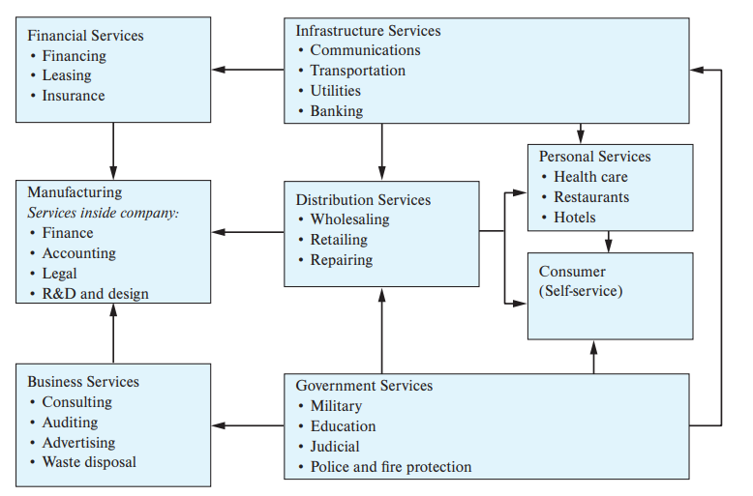
Introduction

Slide 10
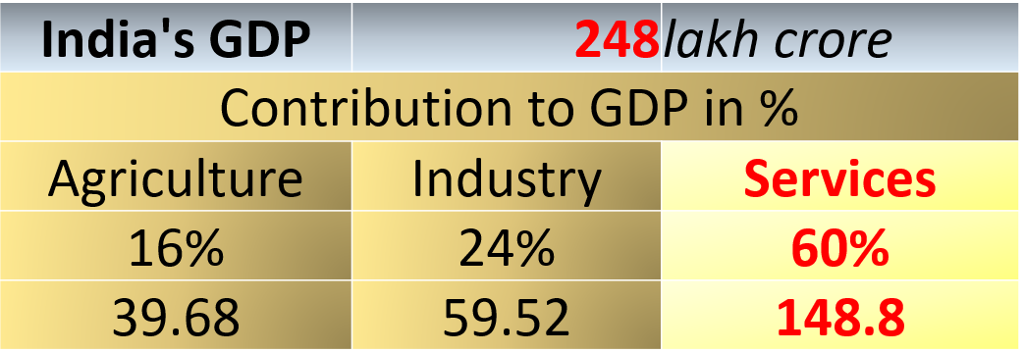
Introduction
Types of Services | % | Value in Lakh Crores
Financial Services | 7 | 10.43
Manufacturing Services | 14 | 20.86
Business Services | 27 | 40.23
Infrastructure Services | 12 | 17.88
Distribution Services | 14 | 20.86
Government Services | 20 | 29.8
Personal Services | 6 | 8.94

Slide 11
Introduction
Types of Services | % | Value in Lakh Crores
Financial Services | 7 | 10.43
Manufacturing Services | 14 | 20.86
Business Services | 27 | 40.23
Infrastructure Services | 12 | 17.88
Distribution Services | 14 | 20.86
Government Services | 20 | 29.8
Personal Services | 6 | 8.94
IT Services 35% 14

Slide 12
Introduction
IT Services 35% 14
My Company:
0.001% Market 100 Crore company

Slide 13
Introduction: Role of services to IE
Employment (Job Creation):
Out of 100 Jobs in the market, how many are Jobs (direct or indirect) are for service industry?
Example: No: of employs of TCS, IRCTC, Emirates Fly. …………..

Slide 14
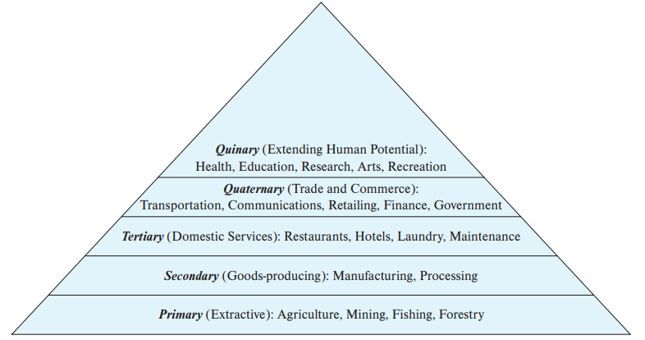
Introduction
Stages of Economic Activity
High paying JOBS
Hierarchy of economic activity

Slide 15
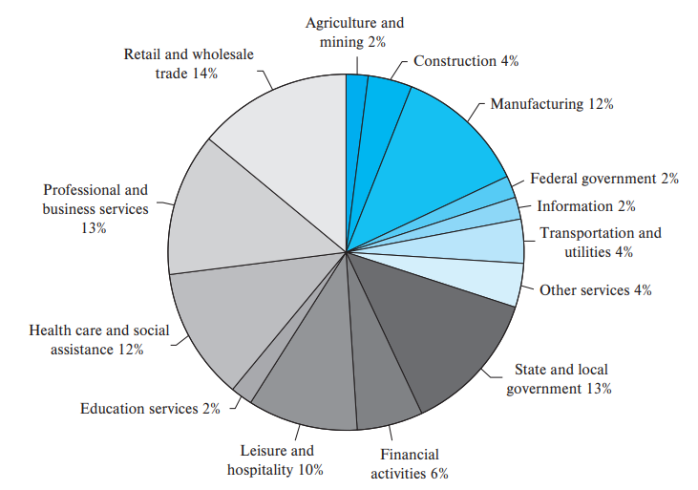
Introduction
Distribution of U.S. Employment by Industry, 2014.

Slide 16
Introduction
Distribution of Indian / (country of your choice) Employment by Industry, 2022.
Assignment:
One short paragraph on Service Job market and distribution of Jobs (Employment) in Indian or any country of your choice.
Do not just write a “Premise”, there should be premise indicator (conclusions or explanation i.e. supporting your premise with reasons / warrant)

Slide 17
Introduction
All economies are service economies.
Service Industry is the highest contributor to global and regional economy because of growing demand for better consumer experience.
Service Industry is the highest contributor to global and regional economy because it has seen an increased growth of 3.17% compared to last year.

Slide 18

Introduction Nature of Services
Differences between services and operations
Retailer is selling GOODS / PRODUCTS
Service:
Free home delivery of purchased goods within an hour
From Consumer’s perspective
(B2C)

Slide 19
Introduction Nature of Services
Differences between services and operations
Retailer using IT software / Internet for quick transactions
Service:
Continuous support from software team & ISP provider
From Retailers perspective
(B2B)

Slide 20
Introduction Nature of Services
Differences between services and operations
Retailer purchasing shelf’s for product display
Service:
Immediate Repair / replacement from Shelf seller in case of malfunctioning
From Retailers perspective

Slide 21
Introduction

Slide 22
Introduction

Slide 23
Introduction

Slide 24
Introduction

Slide 25
Introduction

Slide 26
Introduction

Slide 27
Introduction

